Slide 1

Create Boards With
Various Members

Slide 2

Participation Ranking

Slide 3
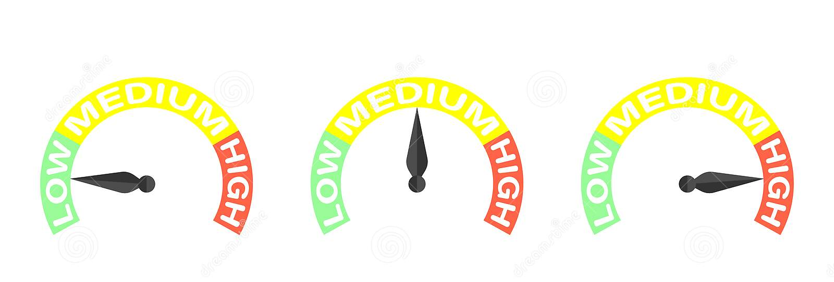
Create Tasks With
Difficulty Level

Slide 4

Free Version
Create Boards With 5 Members.
Create Up To 5 Task Lists
Assign Differentiated Tasks To Each Team Member.
Participation Rankings.
Add Images To Your Favorite Tasks.

Slide 5
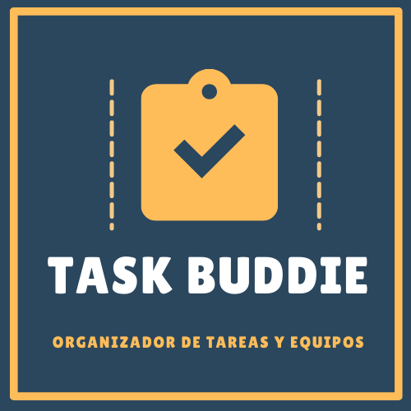
Premium Version
Create Boards With Unlimited Members.
Create Unlimited Task Lists
Assign Differentiated Tasks To Each Team Member.
Participation Rankings.
Assign A Background To Your Favorite Boards.
Add Images To Your Favorite Tasks.
PREMIUM

Slide 6

PREMIUM

